Slide 1
Artificial Intellegence (AI)
Understanding How Computers Learn and Make Decisions"Understanding How Computers Learn and Make Decisions"

Slide 2
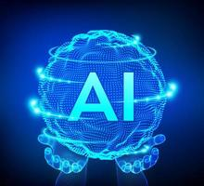
Contents
Introduction.
History of artificial intelligence .
Why AI .
Limitations of human mind .
Applications.
Advantages.
Disadvantages.
Future .
Conclusion.

Slide 3
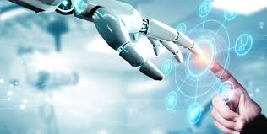
Introduction
Artificial Intelligence, or AI, is all about teaching machines to think and learn like humans do. It's a field in computer science where we create smart machines that can do tasks that typically require human intelligence, such as recognizing speech, understanding language, making decisions, and solving problems. AI helps us automate tasks, make processes more efficient, and even create new ways for technology to assist us in everyday life.

Slide 4
Brief history of AI
1941:First electronic computer(technology finally available )
1956:Term artificial intelligence introduced
1960s:Checkers-playing program that was able to play games with opponents
1980s:Quality control systems
2000:First sophisticated walking robot

Slide 5
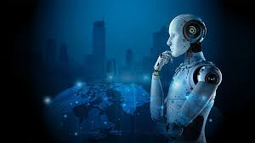
WHY AI?
Computers are fundamentally well suited to preforming mechanical computations,using fixed programed rules .this allows artificial machines to preform simple monotonous tasks effciently and reliadly , which humans are ill-suited to.

Slide 6
Limitations of human mind
Object recognition . people cannot properly explain how they recognize objects
face recognition . cannot be passed on to another person by explanation .
naming of colours . based on learning ,not on absolute standards.

Slide 7
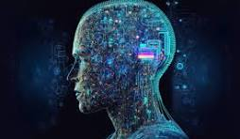
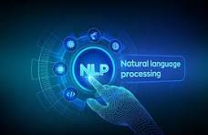

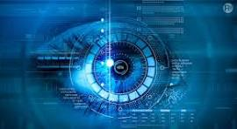
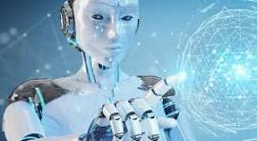
APPLICATION OF AI
Expedrt systems .
Natural language processing (NLP).
Speech recognition .
Computer vision.
Robotics.

Slide 8
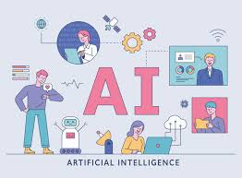
Advantages
Automation: AI can automate repetitive tasks, saving time and reducing errors.
Efficiency: It helps businesses and industries work faster and more efficiently.
Accuracy: AI systems can perform tasks with precision and consistency.

Slide 9
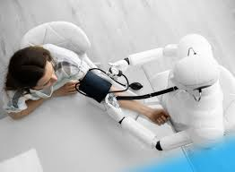
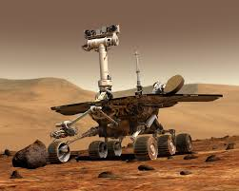
Decision Making: It aids in making better decisions by analyzing large amounts of data.
Personalization: AI can personalize experiences and services based on user preferences.
Safety: It enhances safety by performing risky tasks instead of humans.
Accessibility: AI can make services and information more accessible to people worldwide.

Slide 10
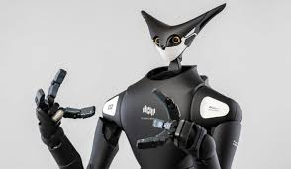
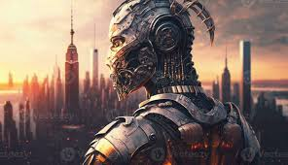
Disadvantages
Job Displacement: AI and automation can lead to job losses as machines replace humans in performing tasks.
High Costs: Developing and implementing AI technology can be expensive, especially for smaller businesses and developing countries.
Privacy Concerns: AI systems often collect and analyze large amounts of personal data, raising concerns about privacy and data security.

Slide 11
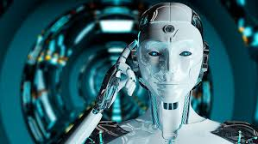
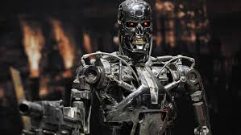
Ethical Issues: AI decisions may not always align with ethical standards or human values, leading to moral dilemmas.
Lack of Creativity: AI can perform tasks based on existing data and rules but may lack human creativity and intuition.
Dependency: Overreliance on AI systems can lead to vulnerabilities if the technology fails or malfunctions.
Bias and Fairness: AI algorithms can reflect biases present in the data used to train them, leading to unfair outcomes or discrimination.
Complexity and Understanding: Understanding and managing AI systems can be challenging, requiring specialized knowledge and skills.

Slide 12
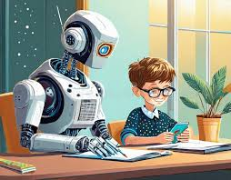
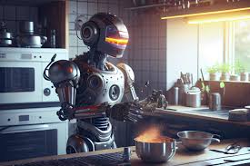
Future(+)
the day is not far when you will just sit back in your cozy little beds and just command your personal robots to entirely do your ruts . he will be a perfect companion for you . just enjoy the technology

Slide 13
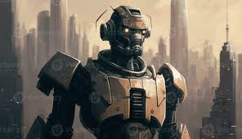
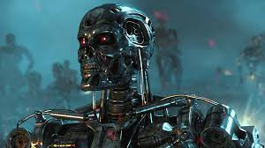
future (-)
but wait, don’t be happy .....!
it may end of other way too.some day there willbe a knock to your doors . as you open it you see a large number of roborts marching into your house destroying everything you own and looting you
this is because ever since there is an advantage in the technology , it attracts anti social elements . this is true for robots too. because now they have full power to think as human , even as of anti social elements . so think trice before giving them the power of cognition

Slide 14
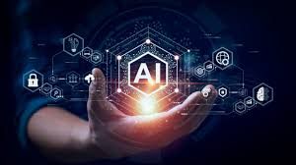
conclusion
In conclusion, Artificial Intelligence (AI) holds immense potential to revolutionize industries, improve efficiency, and enhance our daily lives. However, it also comes with challenges such as job displacement, ethical concerns, and issues related to privacy and bias. As AI continues to evolve, it is crucial to harness its benefits responsibly, ensuring that it serves humanity while addressing its limitations. With careful development and ethical considerations, AI can be a powerful tool for innovation and progress in the future.

Slide 15
thank you

